Slide 1
Optaro.ai
● AI FIRST AGENTIC SUPPLY CHAIN PLATFORM
Your supply chain.
Autonomous. Operational. Now.
Pre-built and trained AI agents for speed to value
Retain your competitive advantage by keeping your data in your world
10–15%
Working Capital
Released
+3%
Revenue Growth
Enabled
14
Days to First
Agent Action
Optaro, an AI first platform, deploys AI agents across your supply chain — sensing demand, rightsizing inventory, and executing decisions to protect EBITDA, release working capital, and unlock revenue growth.
optaro.ai · Confidential
Notes:
Leapfrog your autonomous supply chain journey in days rather than months

Slide 2
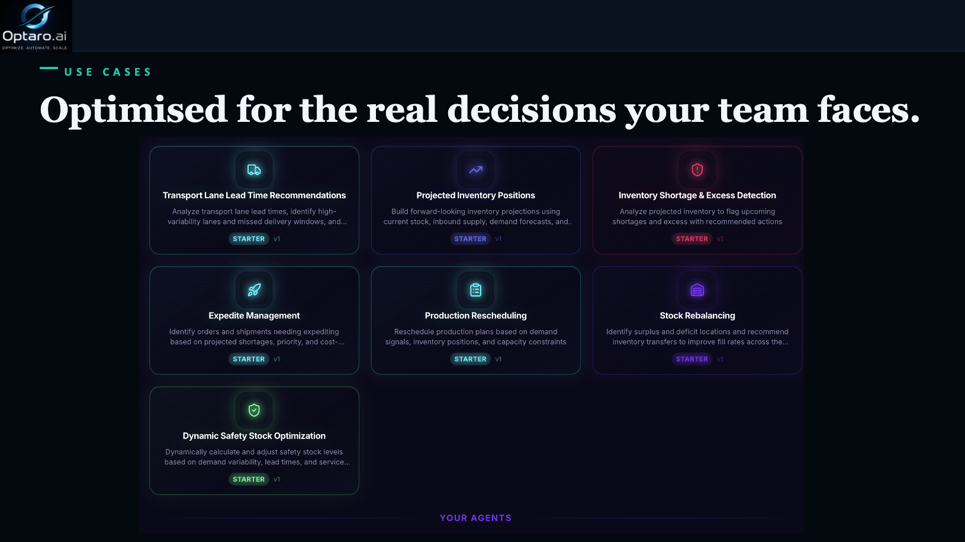
Optaro.ai
USE CASES

Slide 3
Optaro.ai
WHO WE SERVE
Built for complexity at every scale.
From $50M to $5B+ revenue — with a particular fit for businesses that need enterprise-grade supply chain without the enterprise implementation cost or timeline.
$50M – $500M
$500M – $5B+
Mid-Market
Operators
Enterprise
Leaders
Mid-market manufacturers and distributors face a compounding problem: the supply chain has grown complex enough to demand enterprise-grade AI — but the budget, timeline, and IT capacity for a monolithic implementation are nowhere in sight.
Enterprise supply chain leaders have invested heavily in planning platforms, ERP customisation, and analyst teams. The intelligence is there. What's missing is the layer that closes the loop between recommendation and action — autonomously, at the scale and speed global operations demand.
500–50K SKUs, 1–10 locations
SAP, Oracle, OMP, Kinaxis, o9
NetSuite, Dynamics or mid-market SAP
Working capital $50M+ in network
SC excellence without 12-month project
Reduce planner exceptions by 70%+
Enterprise AI, fraction of the cost
CFO-connected supply chain reporting
Partnered with Google Cloud
Who We Serve · Optaro.ai

Slide 4
Optaro.ai
ABOUT OPTARO
"Most AI in supply chain promised transformation and delivered dashboards. We built Optaro because We knew the problem wasn't data — it was that no system would actually act on it."
Mark Robinson
MARK'S BELIEF · IN HIS OWN WORDS
Founder & CEO · Optaro.ai
I believe we are at a genuine inflection point — where AI can move beyond augmenting individual functions and become the connective intelligence that orchestrates decisions across an entire business. My career across Audit, Finance, Supply Chain, and Operations has given me a clear view of where the greatest value sits: not inside any single function, but in the speed and quality of decisions made across all of them together.
CFO / CSCO
VP Digital & AI
PwC Director
EY Trained
Agentic AI makes that possible — systems that don't just surface the right answer but act on it, within guardrails that make autonomous execution something leaders can genuinely trust. Governance has always mattered to me; every decision an agent makes should be traceable and explainable, because accountability is what turns capability into confidence.
We built Optaro to make that vision real — a platform that doesn't just tell you what should happen, but makes it happen.
About · Optaro.ai
optaro.ai · Confidential
25+ yrs

Slide 5


Optaro.ai
See Optaro working

